Slide 1
约伯记19章
2 “你们搅扰我的心， 用言语压碎我要到几时呢？ 3 你们这十次羞辱我， 苦待我也不以为耻。 4 果真我有错， 这错是在于我。 5 若你们真要向我夸大， 以我的羞辱来责备我， 6 就该知道是 神倾覆我， 用罗网围绕我。 7 看哪，我喊冤叫屈，却不蒙应允； 我呼求，却没有公正。 8 神拦住我的道路，使我不得经过；他使黑暗笼罩我的路径。 9 他剥去我的荣光，摘去我头上的冠冕。10 他在四围攻击我，我就走了；他将我的指望如树拔出。11 他向我发烈怒，以我为他的敌人。 12 他的军队一齐上来，修筑道路攻击我，在我帐棚的四围安营。

Slide 2
约伯记19章
13 “他把我的兄弟隔在远处，使我认识的人全然与我生疏。14 我的亲戚都离开了我；我的密友都忘记了我。15 在我家寄居的和我的使女，都当我是陌生人；我在他们眼中被视为外邦人。16 我呼唤仆人，他却不回答；我必须亲口求他。17 我口的气味令我妻子厌恶，我的同胞都憎恶我。18 连小男孩也藐视我；我起来，他们都嘲笑我。19 我的知心朋友都憎恶我；我平日所爱的人向我翻脸。20 我的皮和肉紧贴骨头，我得以逃脱，仅剩牙齿。21 我的朋友啊，可怜我！可怜我！因为 神的手攻击我。22 你们为什么仿佛 神逼迫我，吃我的肉还不满足呢？

Slide 3
约伯记19章
23 “惟愿我的言语现在就写上，都记录在书上；24 用铁笔和铅，刻在磐石上，存到永远。25 我知道我的救赎主活着，末后他必站在尘土上。26 我这皮肉灭绝之后，我必在肉体之外得见 神。27 我自己要见他，亲眼要看他，并不像陌生人。我的心肠在我里面耗尽了！”

Slide 4
约伯记 19章
神是在我的一边还是和我对立的一边？

Slide 5
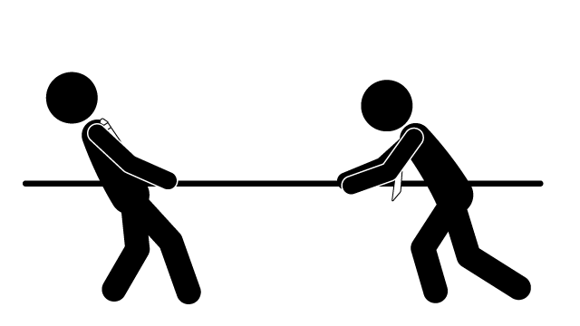
拔河?
圣经里的三一真神
(在我的一边)
正在控制世界的神
(和我对立的一边)
Notes:
Sometimes there seems to be a tension between the God we read in the bible: perfect, righteous, fair, honest and loving and also the character of the “god” who appears to be running the world.

Slide 6
神是在我的一边还是和我对立的一边？
诗篇56:9 我呼求的日子，仇敌都要转身撤退。 神帮助我，这是我所知道的。
罗马书8:31 既是这样，我们对这些事还要怎么说呢？ 神若帮助我们，谁能抵挡我们呢？

Slide 7
神是在我的一边还是和我对立的一边？
鳏夫问
年长的妻子问
职青的人问
年轻人问
疲倦的母亲问
Notes:
Widower: why did she die? We had such plans for our retirement and now, nothing and I am so aloe
Elderly wife: why did he get Alzeihmer’s? Its like watching a car crash in slow motion
Young worker: why did I get into this job? Its terrible and full of frustration
Young adult: why did I have such a difficult childhood? Parents divorcing leading to pain and insecurity…
Weary mother: why was my son born handicapped? So exhausting couldn’t ever have another healthy child who would grow independent…

Slide 8
神是在我的一边还是和我对立的一边？
为什么这些事情发生在我身上？
这位神是生么样的神？为什么他这样把约伯放在这样的情况？
我在圣经看到神爱我、关心我、为我好；但是事实不是这样。反而他好像要把我弄得更糟糕了。
Notes:
What kind of God is it who does what he did to Job, who traps a believer in a prison of barbed wire in suffering, loneliness, pain and misery?

Slide 9
神是在我的一边还是和我对立的一边？
约伯记19章有约伯记的中心思想。
儿童主日学的答案，我们都能背下来。
约伯不会说敷衍了事的答复，因为他比我们更真实
Notes:
We all know the Sunday School answer: Of course God is with us if we are in Christ (Rom 8:31-39). It’s the answer we long to give. However, Job is too honest to give a pat answer. He cant say this while being honest. The first section makes that clear.

Slide 10
神是在我的一边还是和我对立的一边？
那位叫神的怪物不公平的攻击我 The monster god has attacked me unfairly (19:1-12)
那位叫神的怪物残酷地令我被隔绝 The monster god has isolated me cruelly (19:13-22)
三一真神、我们的救赎主 The redeemer God (19:23-27)

Slide 11
那位叫神的怪物不公平的攻击我 (19:1-12)
约伯的感受：那位叫神的怪物（6节之后）
2 “你们搅扰我的心， 用言语压碎我要到几时呢？ 3 你们这十次羞辱我， 苦待我也不以为耻。 4 果真我有错， 这错是在于我。
自食其果
Notes:
Job has experienced a god who is deeply, irrationally and unfairly hostile towards him. He describes this monstrous god from v6, but first he chastises his friends for not supporting him.
How are they doing this (v3) they believe in V4 Job says this is not true for him.
God knows (v5-6)

Slide 12
那位叫神的怪物不公平的攻击我 (19:1-12)
5 若你们真要向我夸大， 以我的羞辱来责备我, 6 就该知道是 神倾覆我， 用罗网围绕我。 7 看哪，我喊冤叫屈，却不蒙应允； 我呼求，却没有公正。 8 神拦住我的道路，使我不得经过；他使黑暗笼罩我的路径。 9 他剥去我的荣光，摘去我头上的冠冕。10 他在四围攻击我，我就走了；他将我的指望如树拔出。11 他向我发烈怒，以我为他的敌人。
Notes:
V6-12 Job describes a god who is deeply hostile to him
V6 God seems to count Job as guilty & closed this trap around him
V7 Job says this is unfair “violence” and calls for help
V8 God who ought to be just to me instead walled him in
V9 God strips Job’s glory from him & reputation
V9-10 all hope is removed. Why?
11 God counts Job as his enemy

Slide 13
那位叫神的怪物不公平的攻击我 (19:1-12)
约伯的朋友以为神也是用自食其果的方式对他
约伯希望耶和华就以此算他为义，但是耶和华就以此算他为不义。

Slide 14
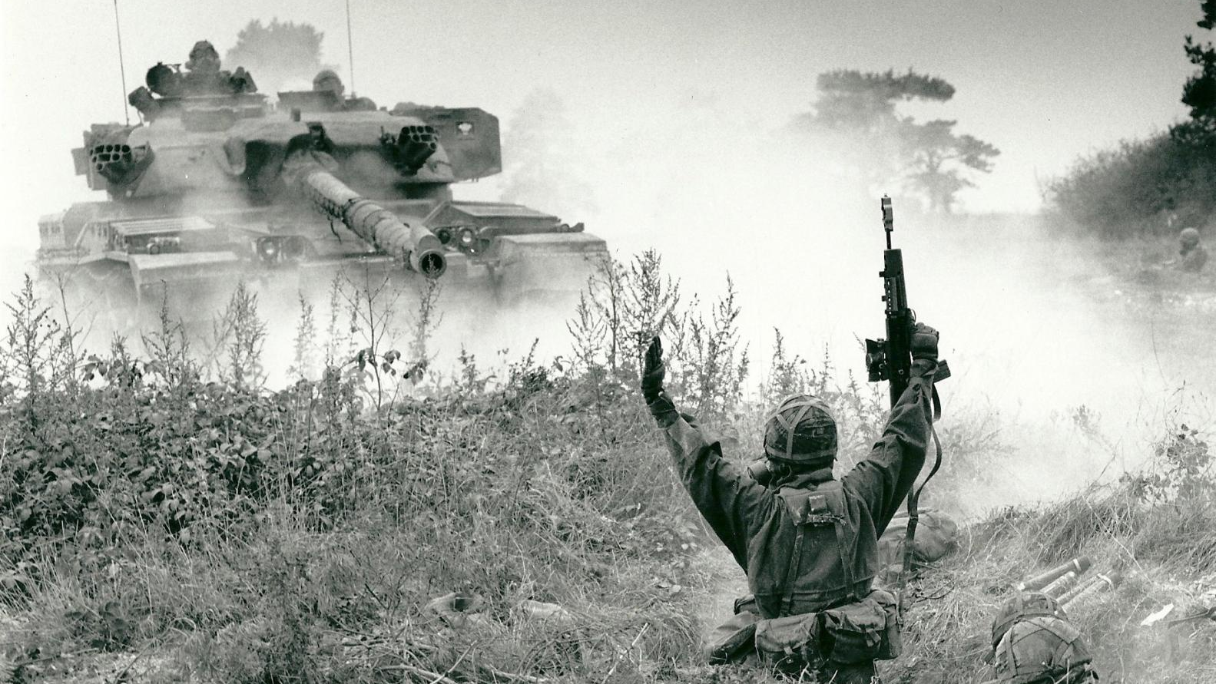
12 他的军队一齐上来，修筑道路攻击我，在我帐棚的四围安营。
Notes:
Job is being a bit over the top with this comment. Its not like God is literally facing off against just him in his little tent!

Slide 15
2. 那位叫神的怪物残酷地令我被隔绝 (19:13-22)
13 “他把我的兄弟隔在远处，使我认识的人全然与我生疏。14 我的亲戚都离开了我；我的密友都忘记了我。15 在我家寄居的和我的使女，都当我是陌生人；我在他们眼中被视为外邦人。16 我呼唤仆人，他却不回答；我必须亲口求他。17 我口的气味令我妻子厌恶，我的同胞都憎恶我。18 连小男孩也藐视我；我起来，他们都嘲笑我。19 我的知心朋友都憎恶我；我平日所爱的人向我翻脸。
Notes:
Job is isolated and suffering alone.
13 – alienated
14 – forgotten
15 – alien a stranger (not even his wife can stand his breath!)
17 – his family loathe him
18 – ridiculed
19 – he is detested

Slide 16
2. 那位叫神的怪物残酷地令我被隔绝 (19:13-22)
20 我的皮和肉紧贴骨头，我得以逃脱，仅剩牙齿。21 我的朋友啊，可怜我！可怜我！因为 神的手攻击我。22 你们为什么仿佛 神逼迫我，吃我的肉还不满足呢？
Notes:
Job sums it up in v21-22.
Is God for me? Clearly not. He picks on Job, isolates him and ruins him
V21 – the hand of God has touched me. Is that true?

Slide 17
2. 那位叫神的怪物残酷地令我被隔绝 (19:13-22)
1：11-12
¹¹ 但你若伸手毁他一切所有的，他必当面背弃你。” ¹² 耶和华对撒但说：“看哪，凡他所有的都在你手中；只是不可伸手加害于他。”于是撒但从耶和华面前退出去。
2 ： 5-6
⁵ 但你若伸手伤他的骨头和他的肉，他必当面背弃你。” ⁶ 耶和华对撒但说：“看哪，他在你手中，只要留下他的性命。”
Notes:
1:11-12. satan, don’t stretch your hand out at him. 2:5-6. It was the hands of Satan, not the hand of God.
Satan is acting within permission of God, but satan’s hands not Gods. Whose hands? Monstrous hands of SATAN! (acting within permission of God)

Slide 18
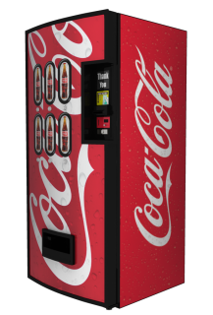
2. 那位叫神的怪物残酷地令我被隔绝 (19:13-22)
上周： 自食其果的神学
Notes:
Job’s friends have no place for Satan in their underatsnding of God’s world. Last week we saw in chapter 4: 自食其果 theology. Like the coke machine opposite from the church.
Job is wondering whose hands these are. If they aren’t God’s whose are they?
But he doesn’t let go that he is a real believer, and he will be vindicated. He just can’t understand why this is happening right now.

Slide 19
3. 三一真神、我们的救赎主 (19:23-27)
23 “惟愿我的言语现在就写上，都记录在书上；24 用铁笔和铅，刻在磐石上，存到永远。25 我知道我的救赎主活着，末后他必站在尘土上。26 我这皮肉灭绝之后，我必在肉体之外得见 神。27 我自己要见他，亲眼要看他，并不像陌生人。我的心肠在我里面耗尽了！”
Notes:
23-24 Job still not happy
23 he longs that his argument of being innocent is put in a book
24 or engraved in a rock forever
Then he says these famous words (25)
26-27 Job is expecting to see God after he died
25: redeemer in the OT is famous. Most famous probably is in Ruth. Kinsman redeemer. A relative comes to help.
What does Job mean here?

Slide 20
3. 三一真神、我们的救赎主 (19:23-27)
27节下“我的心肠在我里面耗尽了！”
Notes:
So who is this redeemer? Surely it is the living God himself. No wonder at the end of verse 27 Job is deeply moved: my heart faiths within me. Literal translation: my bowels fail within me.
In Hebrew the heart is not the seat of emotions. In the OT we do not feel with the heart, but with the bowels. (Chinese example?)

Slide 21
3. 三一真神、我们的救赎主 (19:23-27)
“我最终不会相信这个叫神的怪物是创造这世界的三一真神； 因为我知道我有一位我一直敬畏和喜爱的三一真神，这三一真神与我已经有着立约的关系—我属于祂、祂的家和属祂的人——最终，即使死后，我也会见到祂，祂会为我陈明，让众人公开地看到我是一个真正信祂的而且良心无愧的信徒。”

Slide 22
3. 三一真神、我们的救赎主 (19:23-27)
这位救赎主是谁？
哥林多前书 15章
²⁰ 其实，基督已经从死人中复活，成为睡了之人初熟的果子。
Notes:
In this chapter of 1 Cor, Paul is arguing that our hope in our redeemer is not folly because the fact of the matter is Christ has risen. Not wishful thinking. Not make believer. A sure hope.
Now as Christians we can indeed say: “³⁸ For I am sure that neither death nor life, nor angels nor rulers, nor things present nor things to come, nor powers, ³⁹ nor height nor depth, nor anything else in all creation, will be able to separate us from the love of God in Christ Jesus our Lord.” (Rom 8:38-39)

Slide 23
我知道我的救赎者活着，祂是永活的主， 当我在旷野孤独时，祂伴我作我的灯。 我的救赎者永远活着！

Slide 24
约伯对他的救赎主有盼望
上周：不要关于神《多言多语》
这周：不要关于神《少言少语》
Notes:
Last week I said don’t overstate what we think we know about GOd and what he is doing here. But this week I want to say: lets not underestimate what we do know about God. We know a lot more than Job.

Slide 25
约伯对他的救赎主有盼望
怎么关于神不
《少言少语》呢？
明白撒旦是存在的
对我们的救赎主有盼望
相信神是在我们的一边
Notes:
Last week I said don’t overstate what we think we know about GOd and what he is doing here. But this week I want to say: lets not underestimate what we do know about God. We know a lot more than Job.

Slide 26
约伯对他的救赎主有盼望
25 我知道我的救赎主活着，末后他必站在尘土上。26 我这皮肉灭绝之后，我必在肉体之外得见 神。27 我自己要见他，亲眼要看他，并不像陌生人。我的心肠在我里面耗尽了！”
Notes:
As Christians, even though our life might be ebbing away and our wirck burning low, we can say Job 19:25-28 alongside Job. Lets say it together now.

Slide 27
约伯记 19章
神是在我的一边还是和我对立的一边？

Slide 28
问答时间

